Slide 1
Macroscopic and microscopic
Considered at molecular level
Microscopic, temperature T
Without taking events at molecular level , Macroscopic Volume ,V
energy
System and control volume
energy
syst
Closed system : no mass interaction, only energy
Open system: mass + energy interaction
Isolated system : no mass + no energy
m=fixed
System approach: concentrates on a fixed mass
Control volume approach: focuses on mass and energy flowing across a control surface
Thermodynamic properties:
Every system is described by a physical condition- called property:
For example: P, T V, u s, h, by defining any two property we can fix
the state of the system. When the property changes then the system
is said to be in a changing state or transient state.
p
Path of change of state = process
p
Cyclic process
v
v
Intensive property: Independent of mass P , T
Extensive property: depends on mass vol, energy v, h, u

Slide 2
Phases of a system : 3 phases: solid, liquid and gas
System in single phase homogenous
More than one phase heterogeneous
Thermodynamic equilibrium (TE):
A system is in TE when no change occurs in macroscopic properties
This can only happen when : mechanical, chemical and thermal
Equilibrium exists
Quasi-static process: An almost static process, means a very slow process
1
p
2
If weights are removed suddenly then the gas goes from state 1 to 2,
But the intermediate states are not in TE. If the weights are removed
slowly, one after the other, then the gas changes its state slowly and the
intermediate states are in TE which is shown in the picture.
A quasi-static process is a reversible process.
v
Zeroth law of thermodynamics: If body A is in TE with B and separately with C then body
B and C are in TE

Slide 3
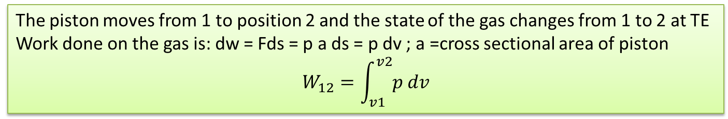
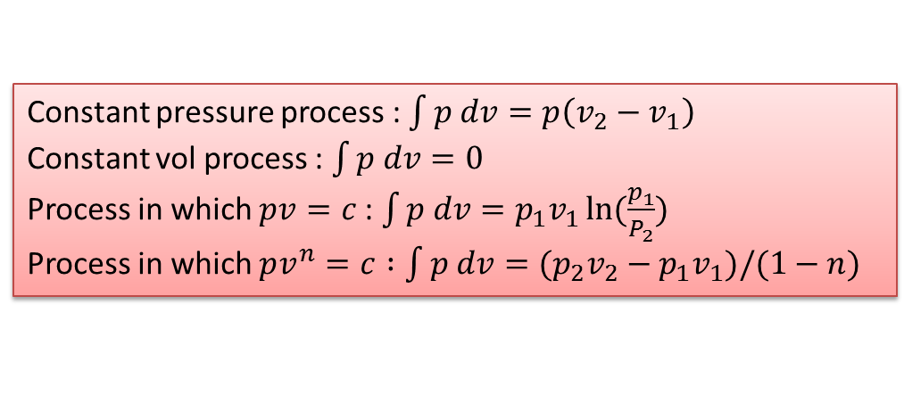
Energy interaction
Closed system energy interaction :
By two ways, heat and work
heat
work
Mechanical work: F.ds = w; work done by a system is conceived to be +ve
Work done on the system is conceived to be –ve work
Pdv work or displacement work:
P2,
v2
P1,
v1
The piston moves from 1 to position 2 and the state of the gas changes from 1 to 2 at TE
Work done on the gas is: dw = Fds = p a ds = p dv ; a =cross sectional area of piston
$$W_{12}=\int_{v1}^{v2}{p dv}$$
Thermodynamic properties are point functions. Work and heat are not thermodynamic property, since
they depend on the path in which the system travels.
Constant pressure process : $\int{p dv=p\left(v_{2}−v_{1}\right)}$
Constant vol process : $\int{p dv=0 }$
Process in which $pv=c$: $\int{p dv=p_{1}v_{1}\ln{(\frac{p_{1}}{P_{2}})}}$
Process in which $pv^{n}=c :\int{p dv={(p}_{2}v_{2}−p_{1}v_{1})/(1−n) }$

Slide 4

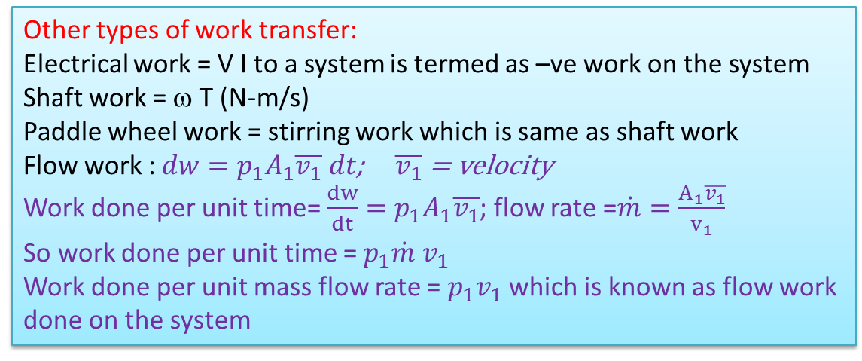
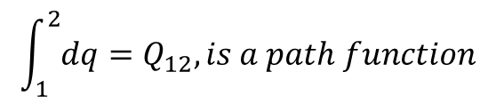
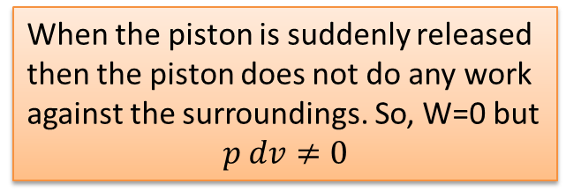

Other types of work transfer:
Electrical work = V I to a system is termed as –ve work on the system
Shaft work = ω T (N-m/s)
Paddle wheel work = stirring work which is same as shaft work
Flow work : $dw=p_{1}A_{1}\overline{v_{1}} dt$; $\overline{v_{1}}$ = velocity
Work done per unit time= $\frac{dw}{dt}={p_{1}A}_{1}\overline{v_{1}}$; flow rate =$\dot{m}=\frac{A_{1}\overline{v_{1}}}{v_{1}}$
So work done per unit time = $p_{1}\dot{m} v_{1}$
Work done per unit mass flow rate = $p_{1}v_{1}$ which is known as flow work
done on the system
Putting a unit flow
Rate into the system
flow
$$A_{1}$$
$$\overline{v_{1}}dt$$
box
When the piston is suddenly released
then the piston does not do any work
against the surroundings. So, W=0 but
$$p dv≠0$$
Free expansion:
vacuum
Gas in
pressure
Heat transfer: is a form of energy transfer across the boundary of a system by virtue of temp
difference
Q -ve
Heat added to the system is termed as +ve
Heat taken out or released from the system is termed as –ve
sys
Q +ve
$$\int_{1}^{2}{dq=Q_{12}, is a path function}$$

Slide 5
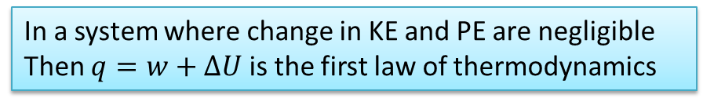
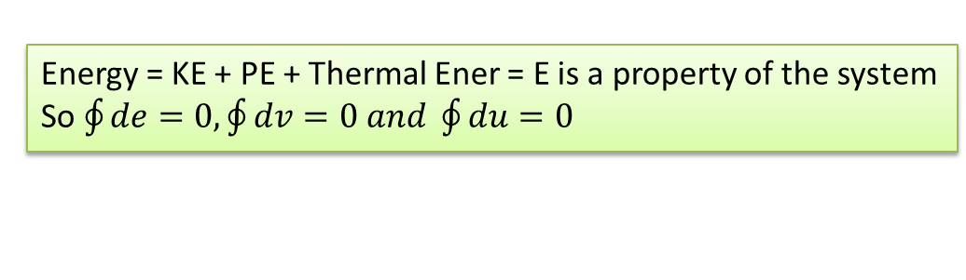

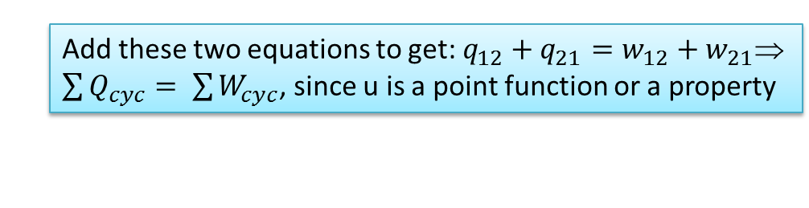

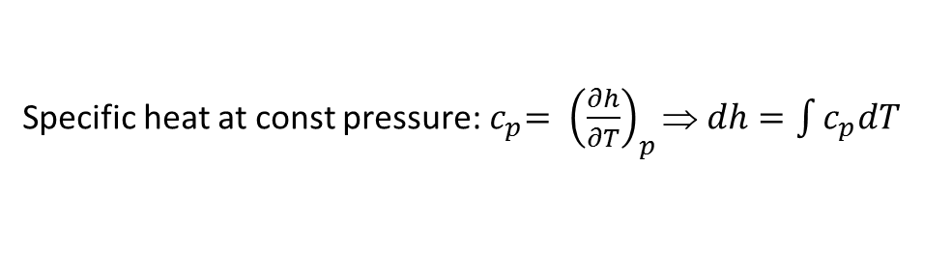

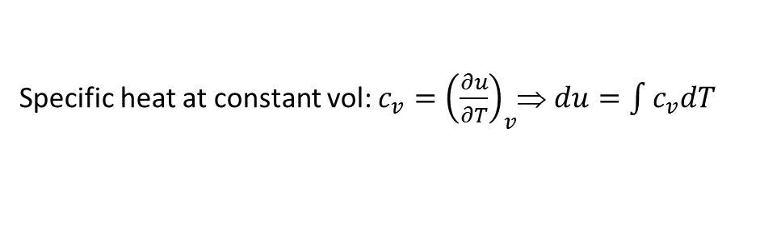
First law of thermodynamics
Work and heat to a system will cause the same effect since they are both energy
First law for a closed system undergoing a process:
w
$$q=w+∆E=w+∆KE+∆PE+∆U$$
sys
q
In a system where change in KE and PE are negligible
Then $q=w+∆U$ is the first law of thermodynamics
1
$$q_{12}=w_{12}+u_{2}−u_{1}$$
First law for a cyclic process
2
$$q_{21}=w_{21}+u_{1}−u_{2}$$
Add these two equations to get: $q_{12}+q_{21}=w_{12}+w_{21}$
$\sum{Q_{cyc}= \sum{W_{cyc}}}$, since u is a point function or a property
Energy = KE + PE + Thermal Ener = E is a property of the system
So $\oint{de=0, \oint{dv=0 and \oint{du=0}}}$
If $q=w+∆u then we can write :dq=dw+du=du+pdv where, dw is replaced$
as pdv work
Specific heat at constant vol: $c_{v}={\left(\frac{∂u}{∂T}\right)}_{v}$⇒ $du=\int{c_{v}dT}$
enthalpy = h = u+pv definition
Specific heat at const pressure:${ c}_{p}= {\left(\frac{∂h}{∂T}\right)}_{p}$ ⇒ $dh=\int{c_{p}dT}$

Slide 6
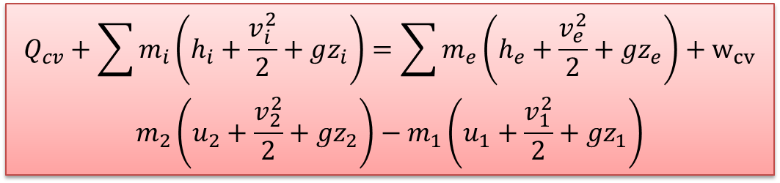


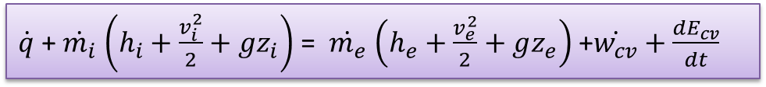


Energy equation for a control volume CV
$$\dot{q}$$
$$\dot{m_{e}}$$
$$\dot{m_{i}}$$
cv
$$\dot{w}$$
Assume property in the CV is uniform
$\dot{q}$ + $\dot{m_{i}}$ $\left(h_{i}+\frac{v_{i}^{2}}{2}+gz_{i}\right)$ = $\dot{m_{e}}$ $\left(h_{e}+\frac{v_{e}^{2}}{2}+gz_{e}\right)$ +$\dot{w_{cv}}+\frac{{dE}_{cv}}{dt}$
(Zero for steady state)
$\frac{{dE}_{cv}}{dt}=\frac{d}{dt}\left(m\left(u+\frac{v^{2}}{2}+gz\right)\right)$ if we integrate the equation wrt to time then we get
$$Q_{cv}+\sum{m_{i}\left(h_{i}+\frac{v_{i}^{2}}{2}+gz_{i}\right)=\sum{m_{e}\left(h_{e}+\frac{v_{e}^{2}}{2}+gz_{e}\right)}}+w_{cv}$$
$$m_{2}\left(u_{2}+\frac{v_{2}^{2}}{2}+gz_{2}\right)−m_{1}\left(u_{1}+\frac{v_{1}^{2}}{2}+gz_{1}\right)$$
Unsteady state energy
Equation for a CV
The most general form of the energy equation for a CV normally used in solving
Thermodynamics problems of any kind

Slide 7


Example -1
N2
N2 at 300K, .5MPa is put to a turbine. The turbine
Operates to a tank pressure of .5MPa where the temp
is 250K. Find the turbine work if the entire process is
adiabatic
Tank
Initially empty
V=50m^3
$m_{i}h_{i}=w_{cv}+m_{2}u_{2}−m_{1}u_{1}$;
$$m_{i}=m_{2}$$
hi=enthalpy(n2, t=300)
U2=intenergy(n2, t=250)
V2=volume(n2, t=250, p=500)
M2=50/v2
EES should solve it

Slide 8
Steam at a pressure of 15bar, t=320C is supplied from a very large vessel to
a turbine through a valve and the exhaust of the turbine is connected to a
.6m^3 tank which is initially empty. The valve opens and the turbine does work
and the steam gets stored in the smaller vessel. If the entire process is adiabatic
then find the work given by the turbine?
Example -2
hi=enthalpy(steam,p=1500,t=320)
v_tank=.6; m1=0
v2=volume(steam,p=1500,t=400)
m2=v_tank/v2
mi*hi=wcv+m2*u2
m2-m1=mi
u2=intenergy(steam,p=1500,t=400)
We have the same equations like example-1
Only the fluid has changed

Slide 9
Example -3
A main supply line in which water flows at 320C, 150MPa, is connected through a valve
to an elastic and adiabatic balloon, which exerts on its contents a pressure that is proportional to its volume. At the beginning of the process the volume of the balloon is zero. The valve is opened and 5 kg of water enters the balloon. The valve closes when the pressure in the balloon is 0.8MPa. Determine the state in the balloon at the end.
hi=enthalpy(water, p=150000,t=320)
mi=5; m2=5
u2=intenergy(water,p=p2, v=v2); p2=800
mi*hi=wcv+m2*u2
wcv=p2*v2_ac/2 { p and v are linearly related}
v2=v2_ac/m2
t2=temperature(water,p=p2,v=v2)
Water
150MPa, 320C

Slide 10
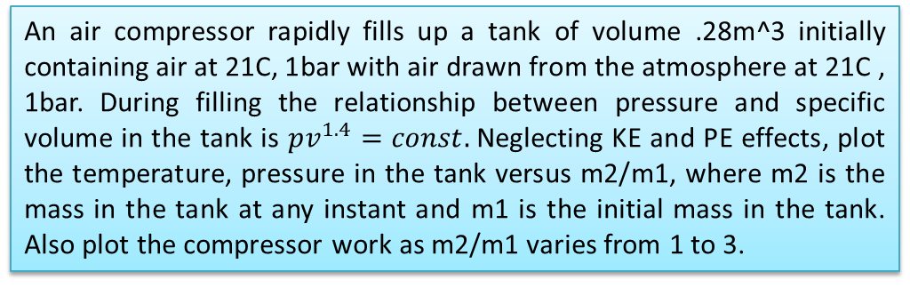
Example-4
An air compressor rapidly fills up a tank of volume .28m^3 initially containing air at 21C, 1bar with air drawn from the atmosphere at 21C , 1bar. During filling the relationship between pressure and specific volume in the tank is $pv^{1.4}=const.$Neglecting KE and PE effects, plot the temperature, pressure in the tank versus m2/m1, where m2 is the mass in the tank at any instant and m1 is the initial mass in the tank. Also plot the compressor work as m2/m1 varies from 1 to 3.
comp
Tank
w
v_tank=.28; t1=21; p1=100; m2/m1=mr
v1=volume(air,t=t1,p=p1)
m1=v_tank/v1
mi*hi=m2*u2-m1*u1+wcv
mi=m2-m1
u2=intenergy(air,t=t2)
t2=temperature(air,p=p2,v=v2)
u1=intenergy(air,t=t1)
hi=enthalpy(air,t=t1)
p1*v1^1.4=p2*v2^1.4
v2=v_tank/m2
Solve through a parametric table

